Slide 1
ASP.NET SignalR and Xamarin
Craig Engelbrecht
Development Team Lead @ Direct Axis
@Craig_Eng / craig.engelbrecht@gmail.com

Slide 2
ASP.NET SignalR is a library for ASP.NET developers that simplifies the process of adding real-time web functionality to applications.
What is
ASP.NET SignalR?

Slide 3
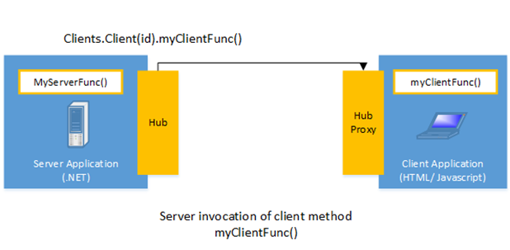
Server Side Invocation

Slide 4
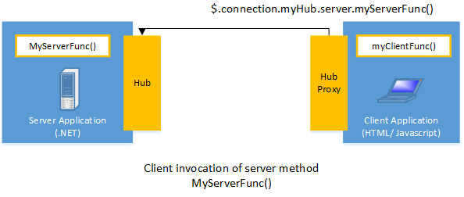
Client Side Invocation

Slide 5
Hubs
A Hub is a high-level pipeline built upon the Connection API that allows your client and server to call methods on each other directly.

Slide 6
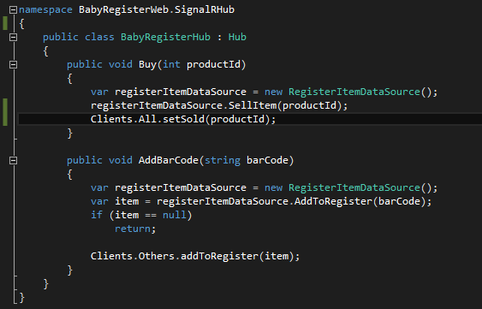
Hubs
Example

Slide 7
Transports
WebSockets
Server Sent Events
Forever Frame
Ajax long polling

Slide 8
Transports
WebSocket is the only transport that establishes a true persistent, two-way connection between client and server.
WebSocket requires the server to be using Windows Server 2012 or Windows 8, and .NET Framework 4.5
WebSocket

Slide 9
Transports
AKA EventSource
Supported by most browsers except IE
Server Sent Events

Slide 10
Transports
Forever Frame creates a hidden IFrame which makes a request to an endpoint on the server that does not complete. The server then continually sends script to the client which is immediately executed
IE Only
Forever Frame

Slide 11
Transports
Polls the server with a request that stays open until the server responds, at which point the connection closes, and a new connection is requested immediately.
This may introduce some latency while the connection resets
Ajax long polling

Slide 12
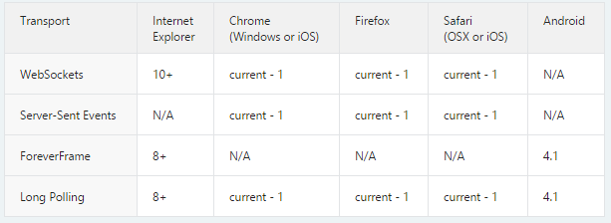
Transports
Overview

Slide 13
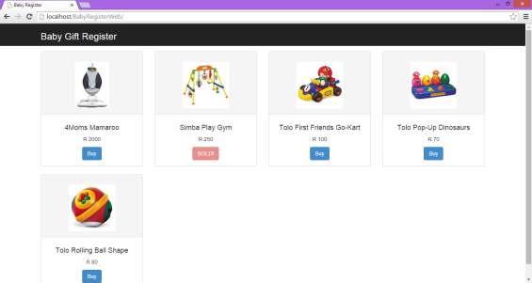
Web Application

Slide 14




Mobile Application

Slide 15
References
http://www.asp.net/signalr
http://beta.pluralsight.com/courses/signalr-across-web-devices

